Slide 1

Beyond Melody: A Text Mining Approach on Song Success on Spotify
Submitted by: Boddapati Kanchana (24MBMB02)

Slide 2




Executive Summary
Integrated Analysis
Methodology
The study explores the influence of lyrics, audio features, and linguistic diversity on song success on the Spotify platform.
A robust framework combining text mining, sophisticated machine learning (ML), and statistical modeling was employed.
Five Core Use Cases
Key Deliverables
Five distinct use cases were developed to capture various perspectives of music analytics, from themes to sentiment.
Findings offer crucial data-driven insights for artists, music producers, and major streaming platforms to optimize content strategy.

Slide 3




Objectives
Popularity Drivers
Applied Analytical Models
Identify the multivariate factors (lyrical, acoustic, cultural) that significantly influence Spotify song popularity.
Apply analytical models for: Theme classification, Genre prediction, Cross-cultural success, Audio feature influence, and Sentiment analysis.
Pattern Interpretation
Interpret the emotional, musical, and cultural patterns embedded within the characteristics of popular music.

Slide 4

Scope and Methodology
Dataset and Features
Dataset Size: Integrated Spotify and Lyrics datasets, encompassing approximately 4,000+ unique songs.
Textual Features: Detailed analysis of Lyrics (content, complexity) and language identification.
Numerical Features: Core Spotify audio attributes (e.g., Danceability, Energy, Loudness).
Categorical Features: Genre, thematic classifications, and sentiment scores.
Tools Utilised
Programming: Python, Pandas (Data Manipulation)
Modeling: Scikit-learn (Machine Learning)
Text Analysis: TextBlob (Sentiment & NLP)
Visualisation: Matplotlib, Seaborn

Slide 5

The Analytical Workflow
Random Forest Models
Dataset Collection
Gather lyrics and audio
Genre and popularity
Keyword & Sentiment Analysis
Data Cleaning
Analytical Workflow
Normalize and preprocess
Theme and emotion
Audio (Spotify)
Text (Lyrics)
Prepared audio features
Prepared textual data

Slide 6
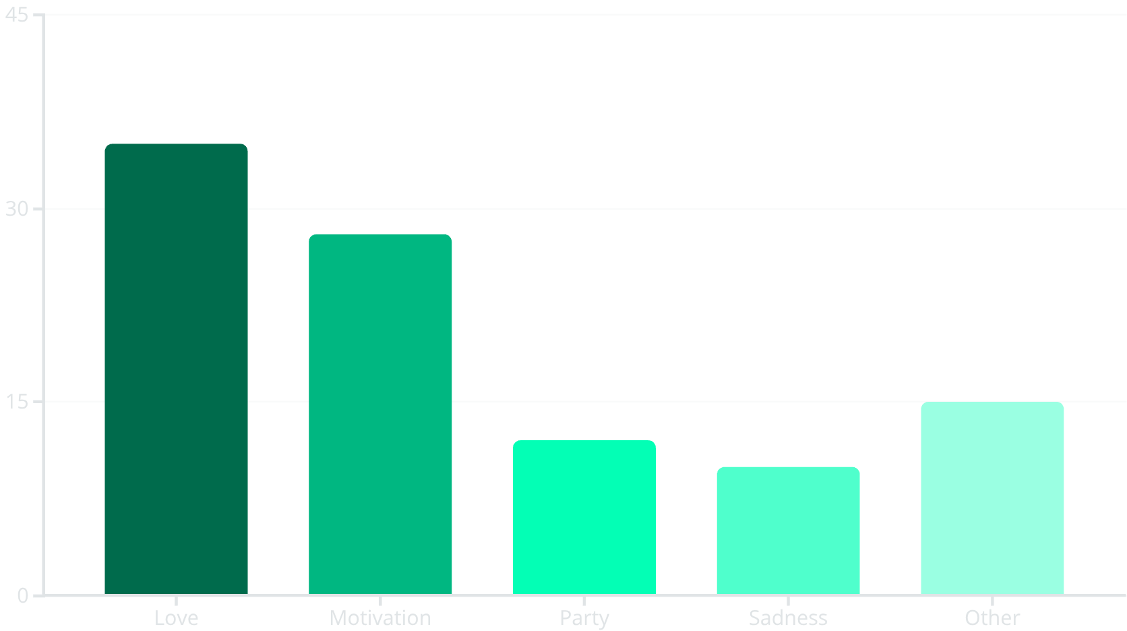
Use Case 1 & 2: Lyrical Themes and Genre Prediction
Use Case 1: Theme Classification
Use Case 2: Genre Classification
Objective: Identify the dominant lyrical themes using keyword-based classification.
Objective: Predict song genres based solely on audio features using a Random Forest Classifier (n_estimators=200).
Accuracy: High classification accuracy, particularly for dominant genres like Pop, Hip-Hop, and Rock.
Key Features: Genre boundaries are sharply defined by Energy, Valence (musical positivity), and Danceability.
Observation: Minor overlaps were observed between closely related sub-genres (e.g., Pop-Rock).
Insight: Audio features function as highly effective, quantifiable markers for defining musical genre.
Insight: Songs expressing emotional positivity and aspirations (Love and Motivation) significantly dominate modern popular music themes.

Slide 7



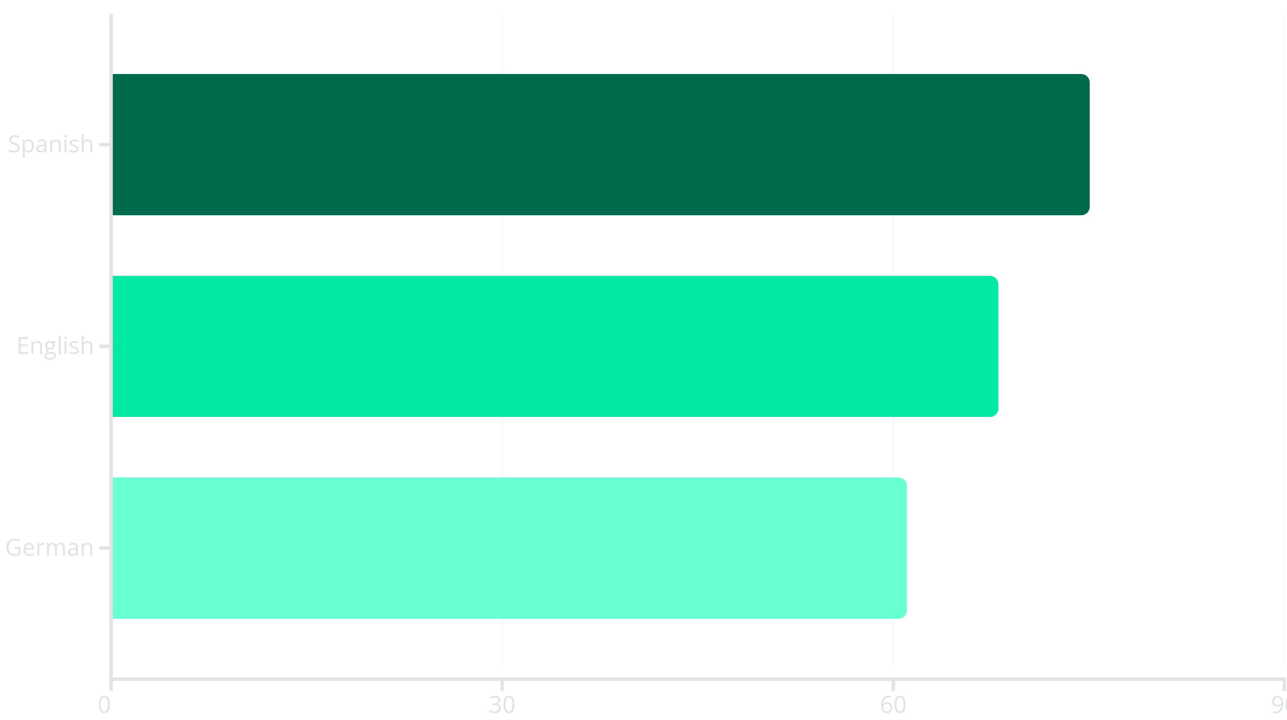
Use Case 3: Evaluating Cross-Cultural Success
Objective: Evaluate how the primary language of the lyrics influences a song's average Spotify popularity score globally.
Spanish Dominance
English and German
Global Trend
Songs primarily in Spanish ranked the highest in average popularity across the dataset, reflecting the global reach of Latin music.
English remained a strong contender, followed closely by German songs, underscoring the influence of these markets.
The data indicates that Latin and multilingual music are leading global streaming trends and listener engagement.

Slide 8










Use Case 4: Audio Feature Impact on Popularity
Objective: Identify which intrinsic audio attributes have the most significant linear influence on Spotify popularity scores.
Energy
Loudness
High energy tracks (intensity, activity) are consistently favored by listeners and algorithms.
A strong positive correlation, suggesting commercially successful songs are mastered to be loud.
Liveness
Higher values, indicating elements of live performance or strong presence, boost success.
Model Performance
Random Forest Regressor achieved high performance (R² ≈ 0.7) with low Mean Absolute Error (MAE).
Tempo
The pace of the song is a defining feature in what makes a track catchy and popular.
Insight: Commercially successful songs are generally characterized by being loud, high in energy, and having a lively feel, optimized for dynamic listening environments.

Slide 9
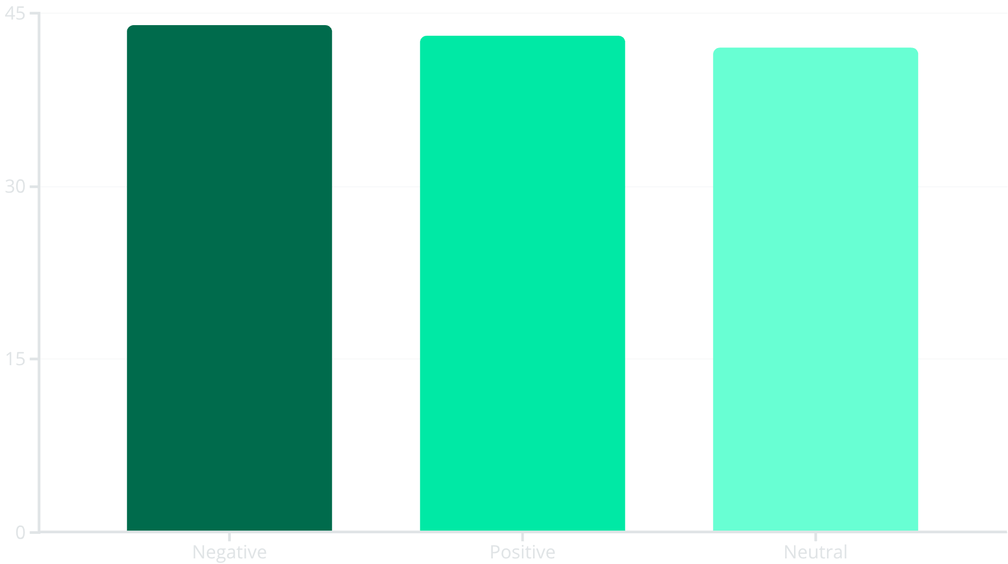


Use Case 5: Lyrical Sentiment vs. Popularity
Objective: Analyse how the sentiment (emotional tone) of lyrics correlates with average song popularity using TextBlob polarity scores.
The Power of Depth
Songs with highly Negative lyrical polarity registered the highest average popularity score in the sample.
This suggests that emotionally deep, introspective, or even melancholic lyrics often connect more strongly and deeply with mass audiences than purely positive or neutral content.

Slide 10
Overall Findings and Strategic Takeaways
Synthesising the results from all five use cases provides a holistic view of the drivers for Spotify song success.
Theme
Love & Motivation dominate lyrics, but deeper, complex emotions are highly engaging.
Genre
Energy & Valence effectively define genres; audio features are crucial for categorization.
Language
Spanish music shows the highest average global popularity, pointing to diverse market success.
Audio
Loudness, Energy, and Liveness are top technical features driving listener engagement and popularity.
Sentiment
Emotionally deep or negative lyrical content slightly increases audience connection and engagement metrics.

Slide 11
